Slide 1
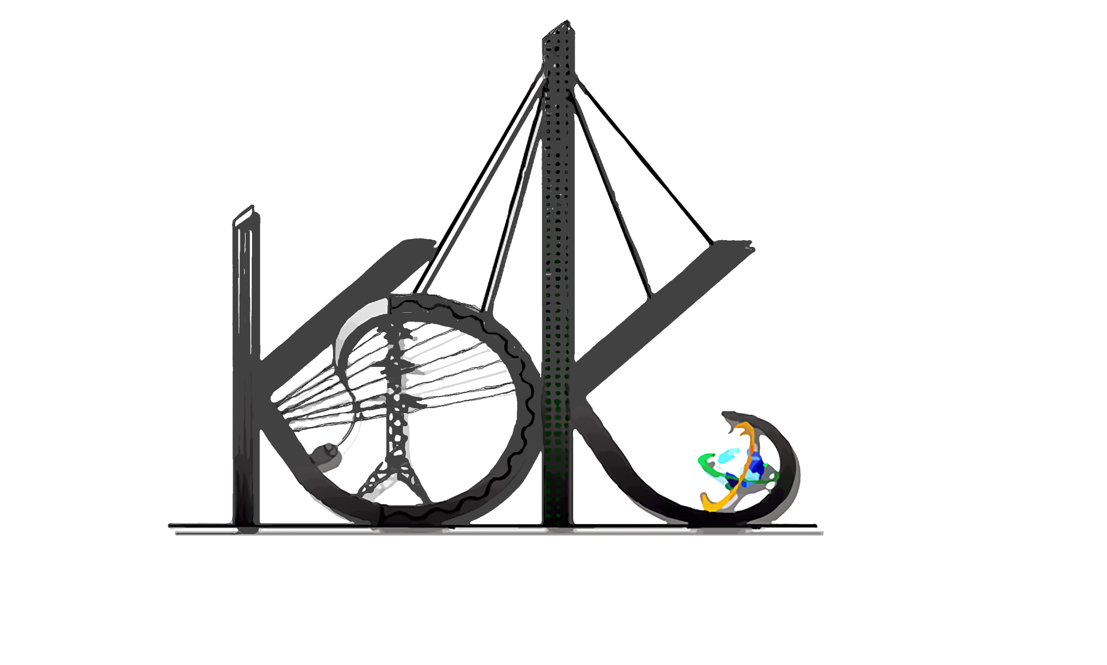
K.D.K College Of Engineering, Nagpur
Department Of Computer Technology
Session 2018-19
AI Based Voice Assistant Using Python (AIVA)
Guide:
Prof.
Anup Bhange
Name of Projecties:
Deepak Shende (113)
Aishwarya Bhisikar (103)
Ria Umahiya (209)
Monika Raghorte (130)

Slide 2
Content
Introduction.
WorkFlow.
Literature survey.
Problem statements.
Objectives.
Implementatin Tools.
Experimental setup & result.
References.

Slide 3

Introduction
The AIVA is a Virtual Assistant Virtual powered by Artificial Intelligence .
What AIVA can do?
It is able to search the Internet, as if the user gives any query to AIVA it automatically goes to the Internet and get the best fit result for the user’s query by saying search in the starting of the query.
AIVA can post comments on the social media websites such as Facebook, Twitter, etc. By just few simple commands.
User can get the talk back responsive solution for the respective query.
It can open and launch web-applications and the local storage of the user computer.
AIVA is the user friendly AI assistant to make the communication more easier between the user and the machine.

Slide 4
WorkFlow
Audio command
Microprocessor
Speech Recognition Module
Central Processor
Routines

Slide 5
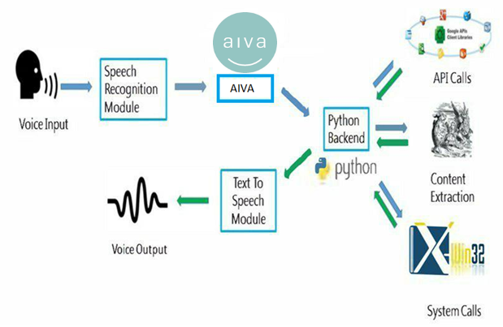

Slide 6
Literature Survey
There are few more assistants like Alexa, Cortana, and Google Assistant but non of them are able to do the stuffs such as interacting on the social media sites.
Other assistants available now are not able to manage user local storage data instead of Microsoft Cortana.
If one is able to do storage work than other is not able to do so and vise versa but Blue is an AI that will do both the tasks easily.
A Survey was done which shows that the user familiar with assistants are more creative and able to do their work faster.

Slide 7
VIRTUAL ASSISTANT | USES
Apple Siri | 34%
Google Assistant | 19%
Amazon Alexa | 6%
Microsoft Cortana | 4%
Uses of Virtual Assistant

Slide 8
Problem Statements
As we know that the machine working speed is many ways faster than the human so by the research it is proven that humans are more faster in verbal than performing tasks.
Visually disabled users also had problems working with the Computers and they have to be dependent on others for their works so to help visually disabled user AIVA will be an huge advantages.
User find it more interesting when interacting with an responsive program or like an assistant that can make their work easier and reduces their work of doing each and every thing by themselves.
Now a days human beings are getting too lazy and everyone need an assistant for their work so Blue is going to be the perfect voice AI assistant for such users.

Slide 9
Objectives
AIVA should be able to work with variety of commands.
Opening and launching social media applications can be done easily just by using commands. Posting things on social media by voice command and can login\logout of social media websites by the commands.
Help the user with finding results available on the Internet by just asking AIVA all the questions like what, who, why, when.
To perform operations like deleting, creating new files on the local storage and also opening folders of the user.
AIVA will also be able to play song and videos on both local storage and Internet by saying play command and the name of the song with it.
User can any time get the latest climate condition around him\her just by asking AIVA what is the temperature now.
AIVA is an AI assistant that automatically update itself with the trending things on the Internet.

Slide 10
Implementation Tools
Software :
PyCharm :- PyCharm is an integrated development environment (IDE) used in computer programming, specifically for the Python language.
Python :- Python is an interpreted, high-level, general-purpose programming language. Created by Guido van Rossum and first released in 1991.
AWS :- Amazon Web Services (AWS) is a subsidiary of Amazon that provides on-demand cloud computing platforms to individuals, companies and governments, on a paid subscription basis.
Hardware :
Computer System.
Speakers.
Mic.

Slide 11
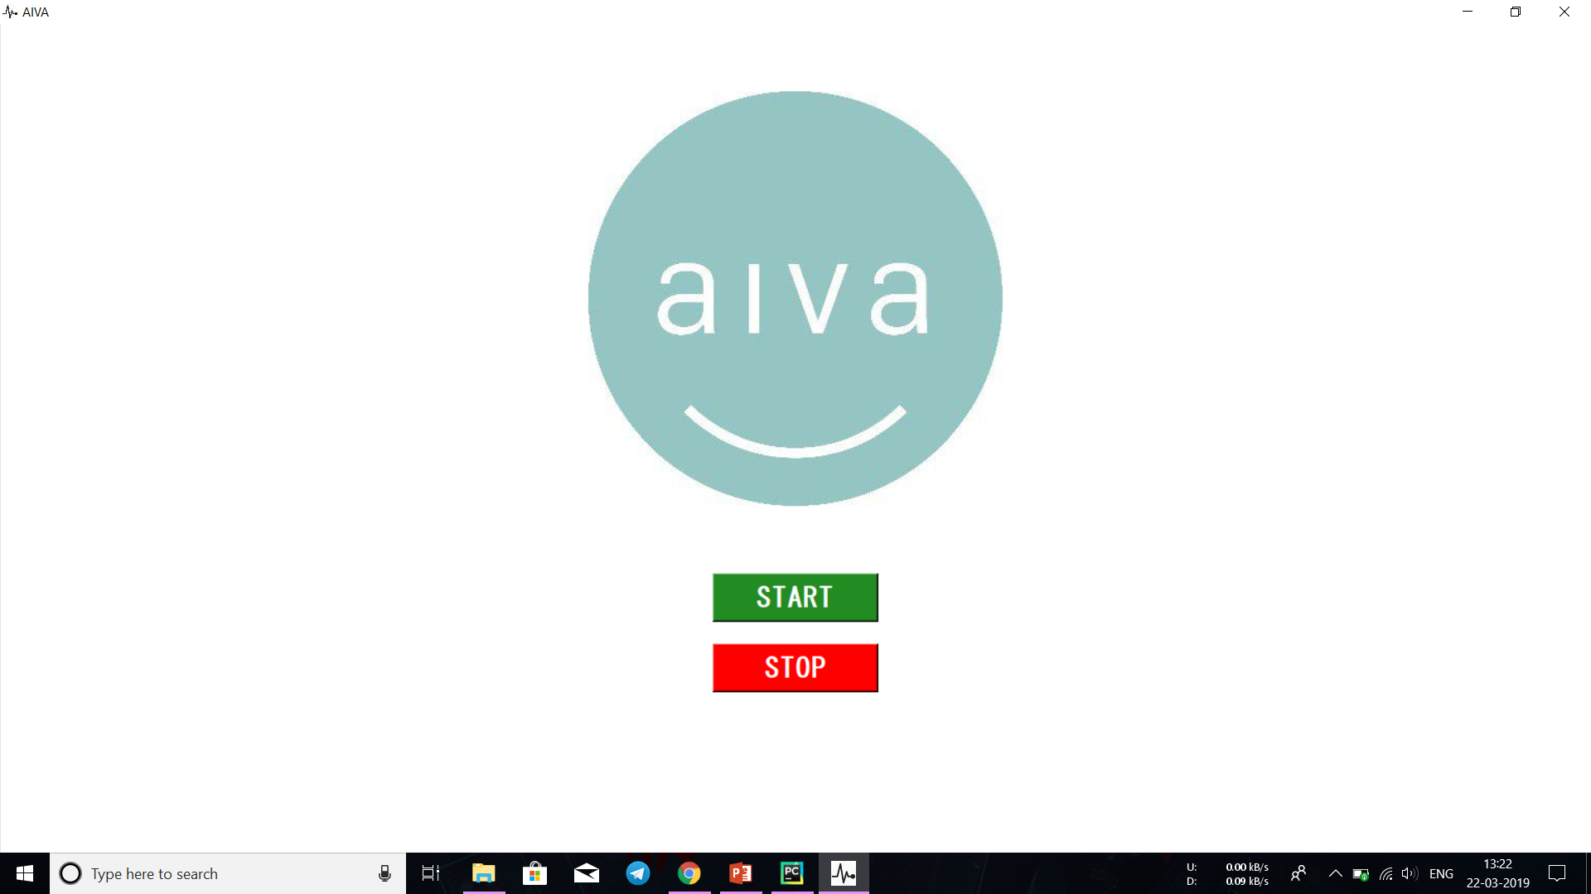
Experimental Setup & Result
Face of AIVA (Front-End) :

Slide 12
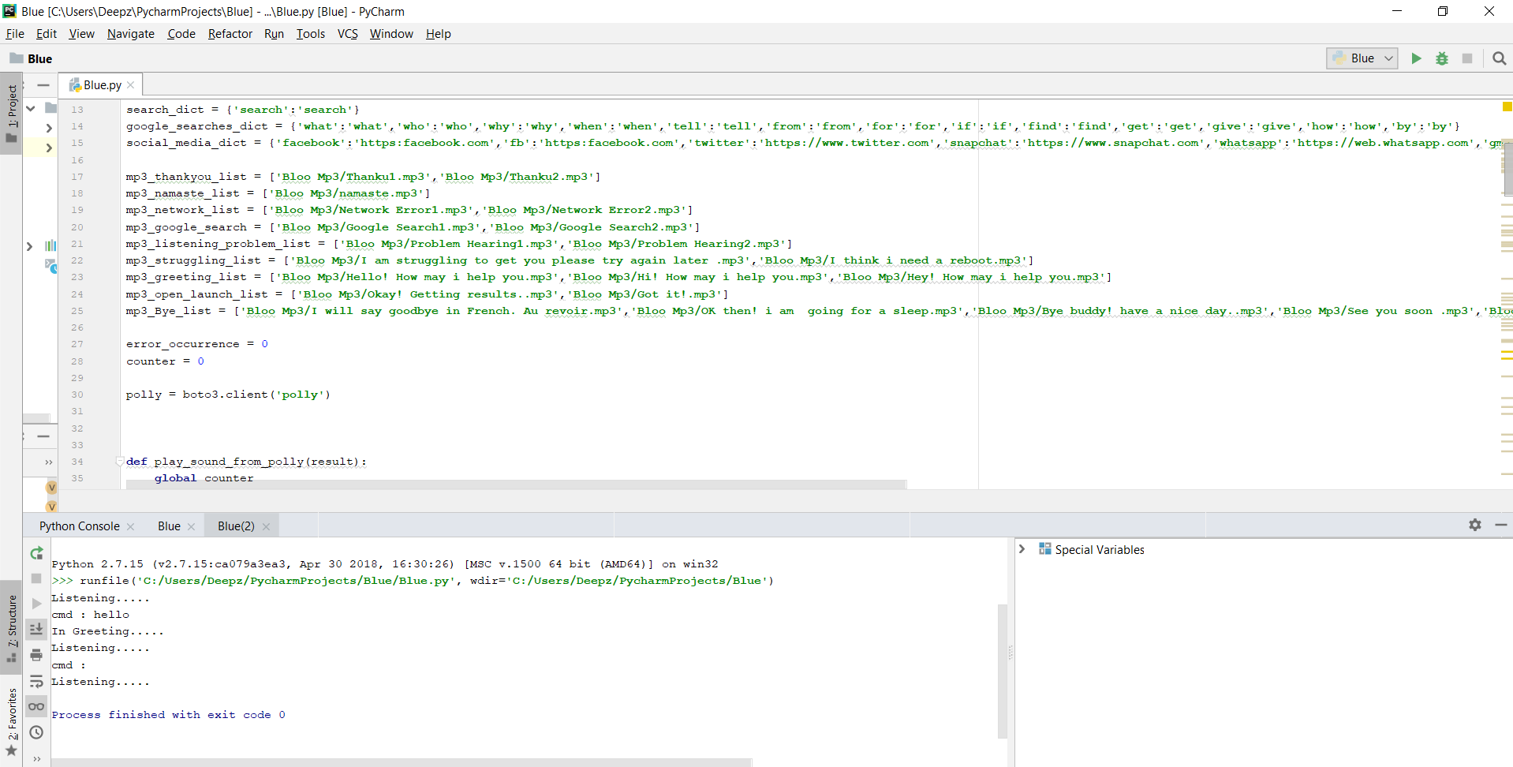
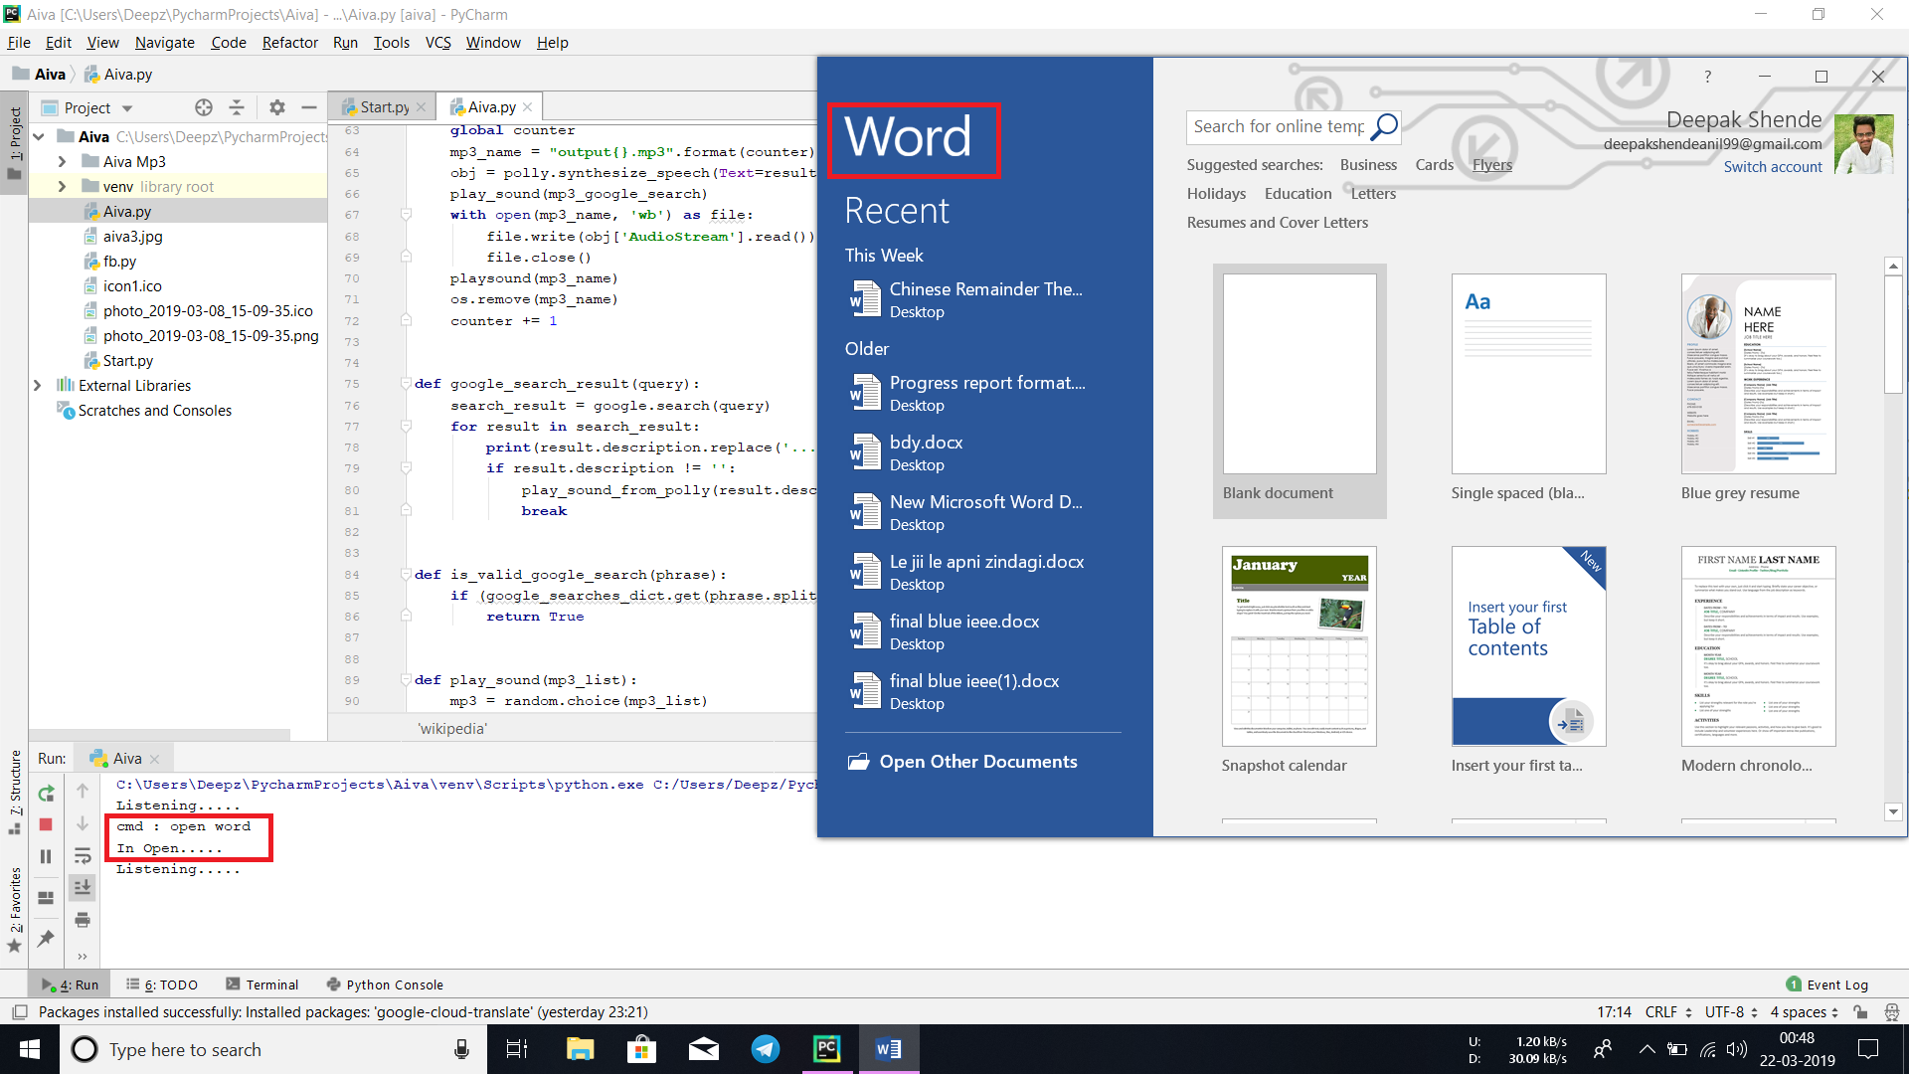
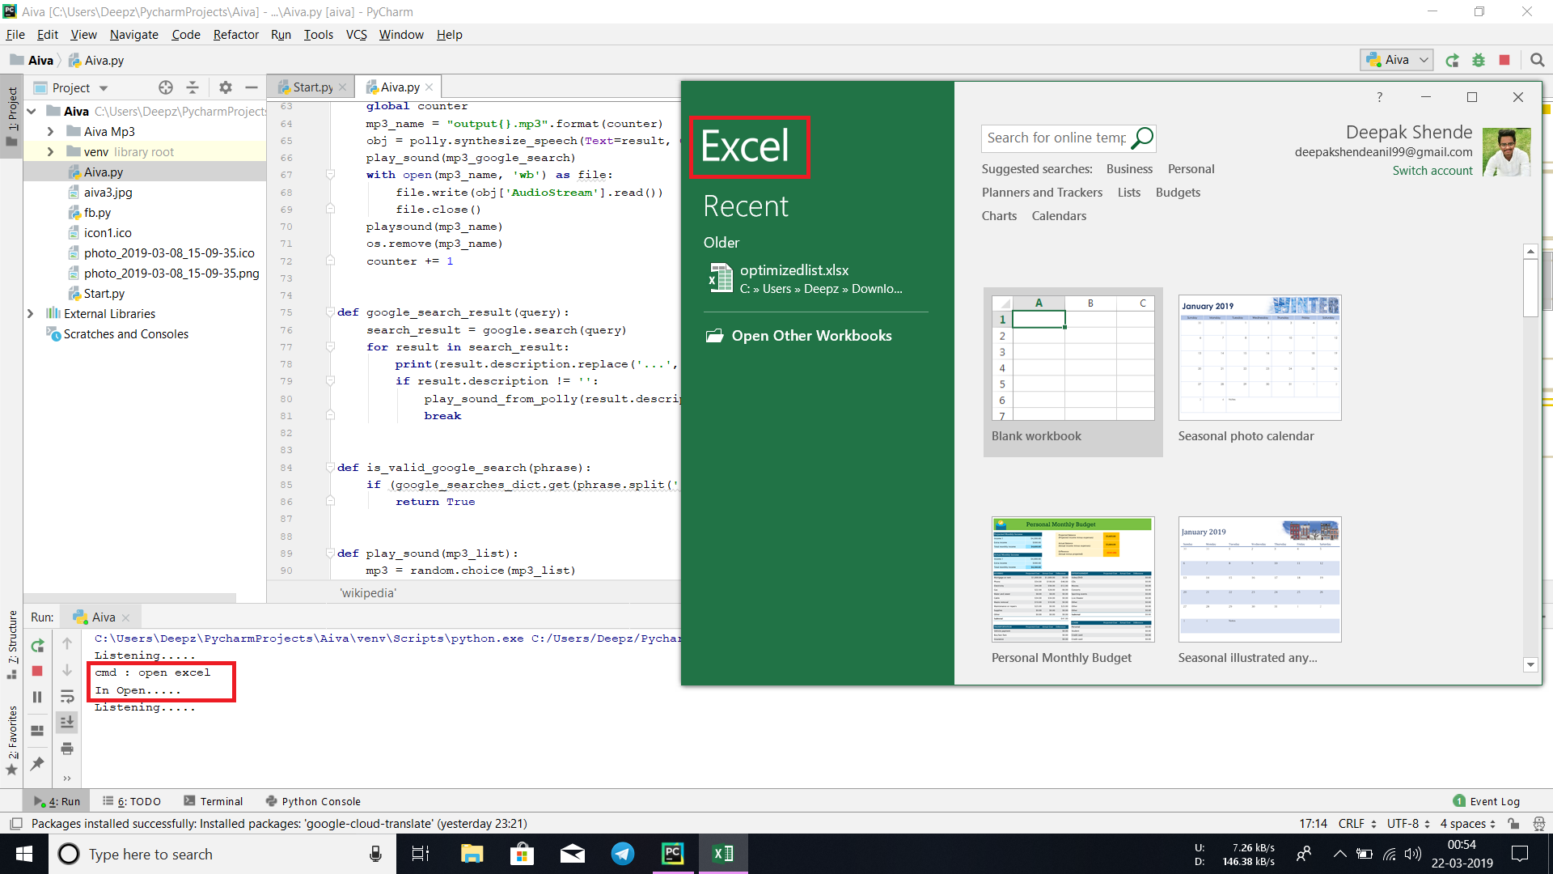
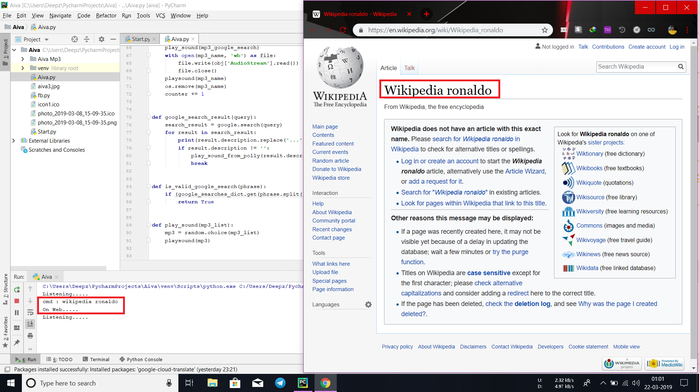
Response on Hello/Hi/Hey:
Response on Open Word:
Response on Open Excel:
Response on Wikipedia Commands:
Facebook

Slide 13
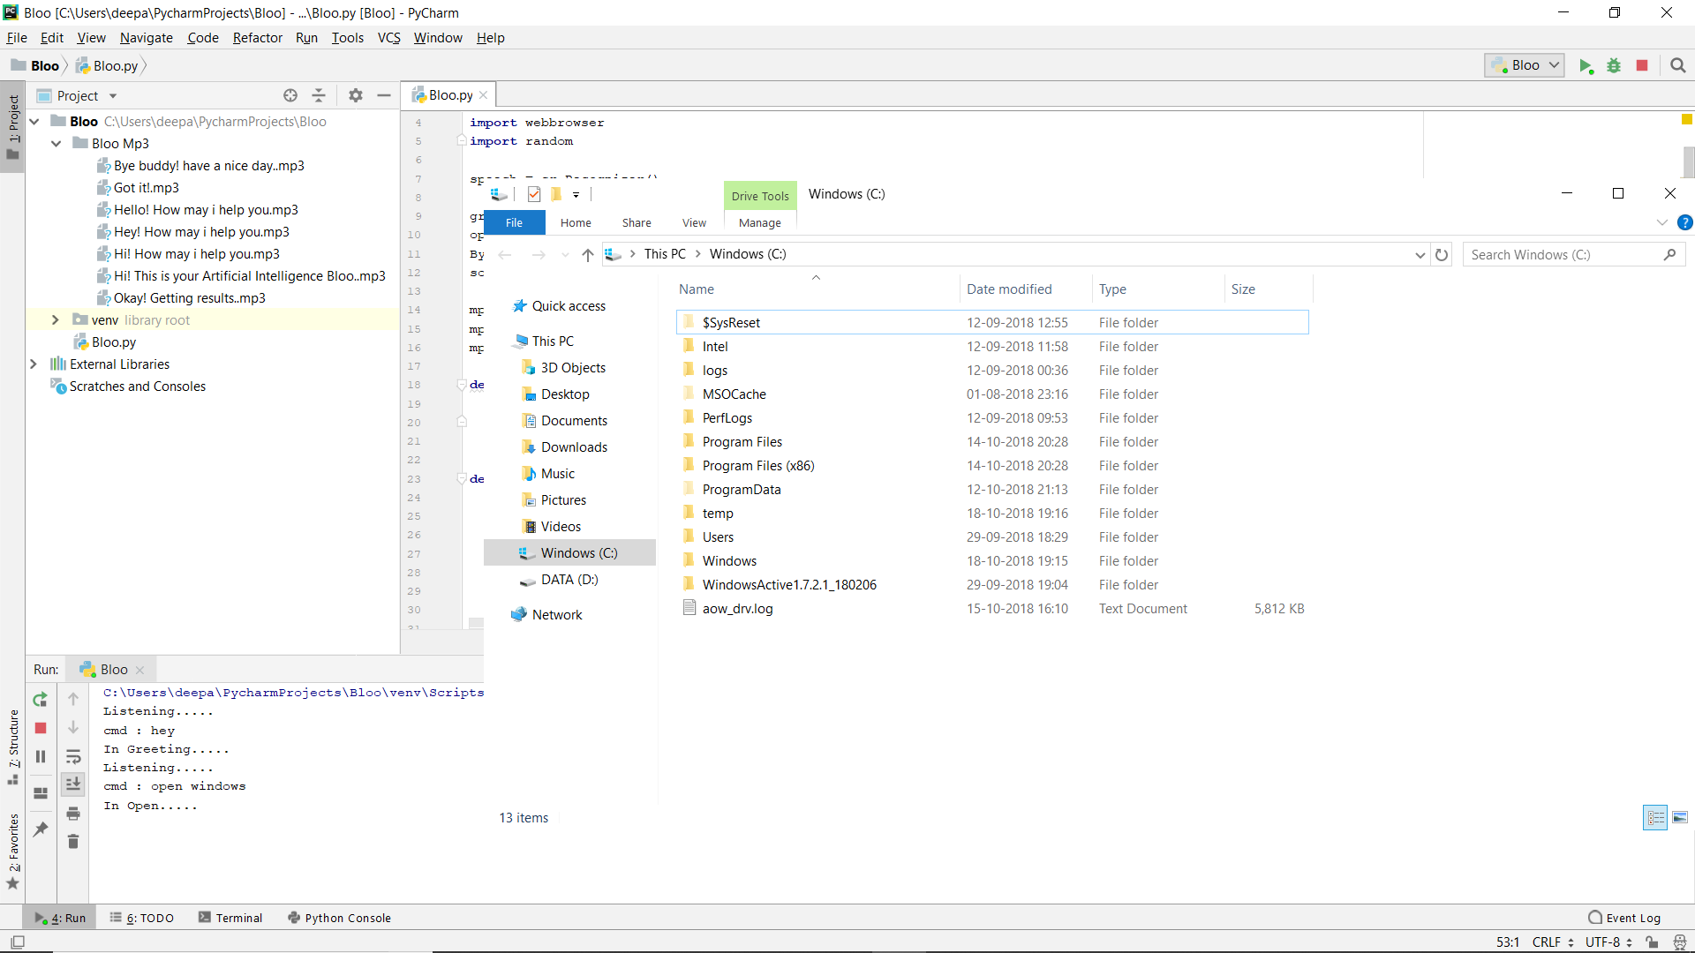
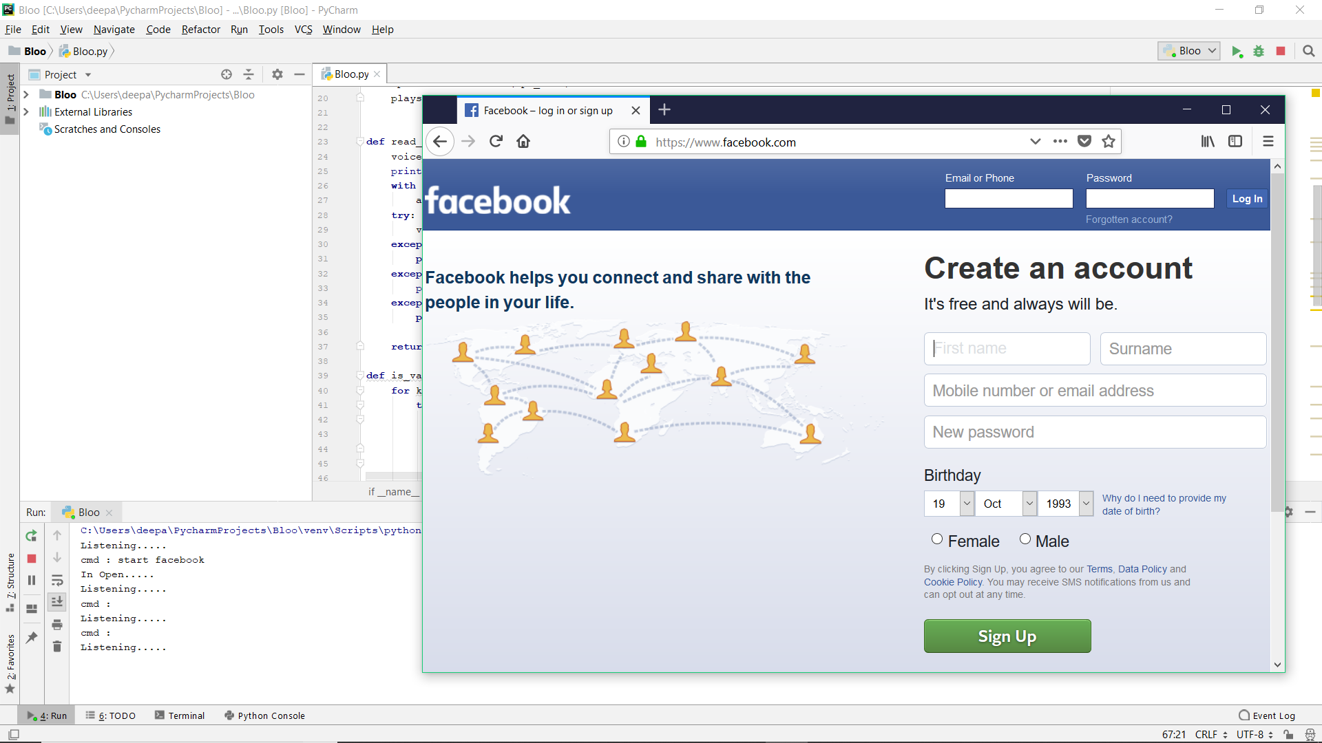
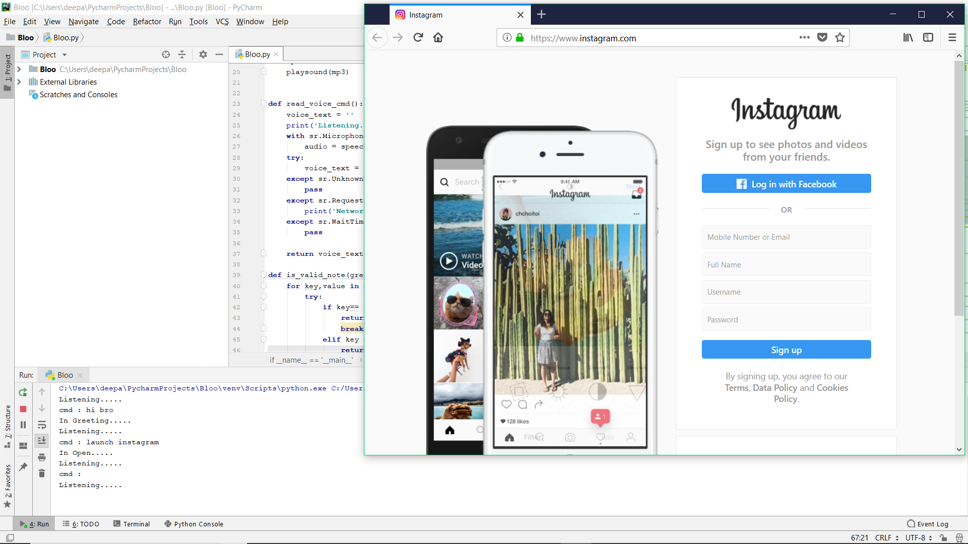
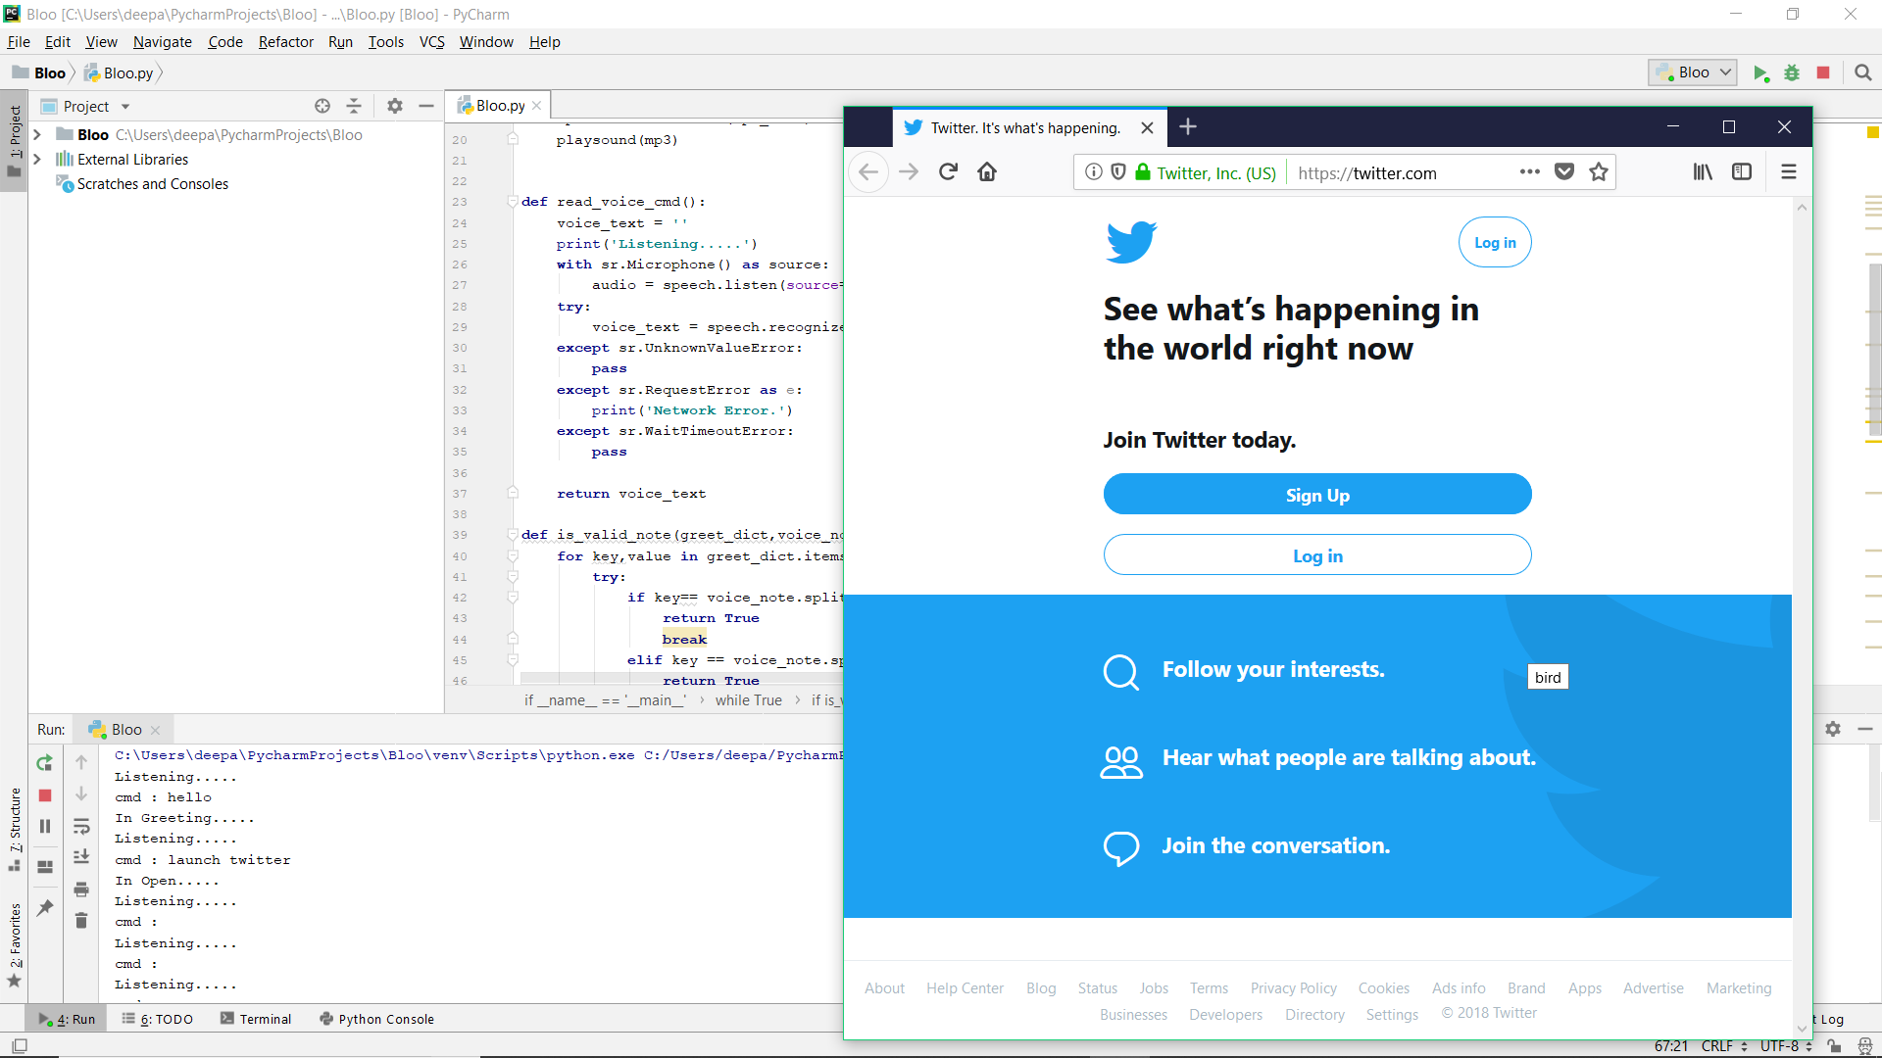
Response on commands to open Local Storage:
Response on Facebook:
Response on Instagram:
Response on Twitter:
Facebook

Slide 14
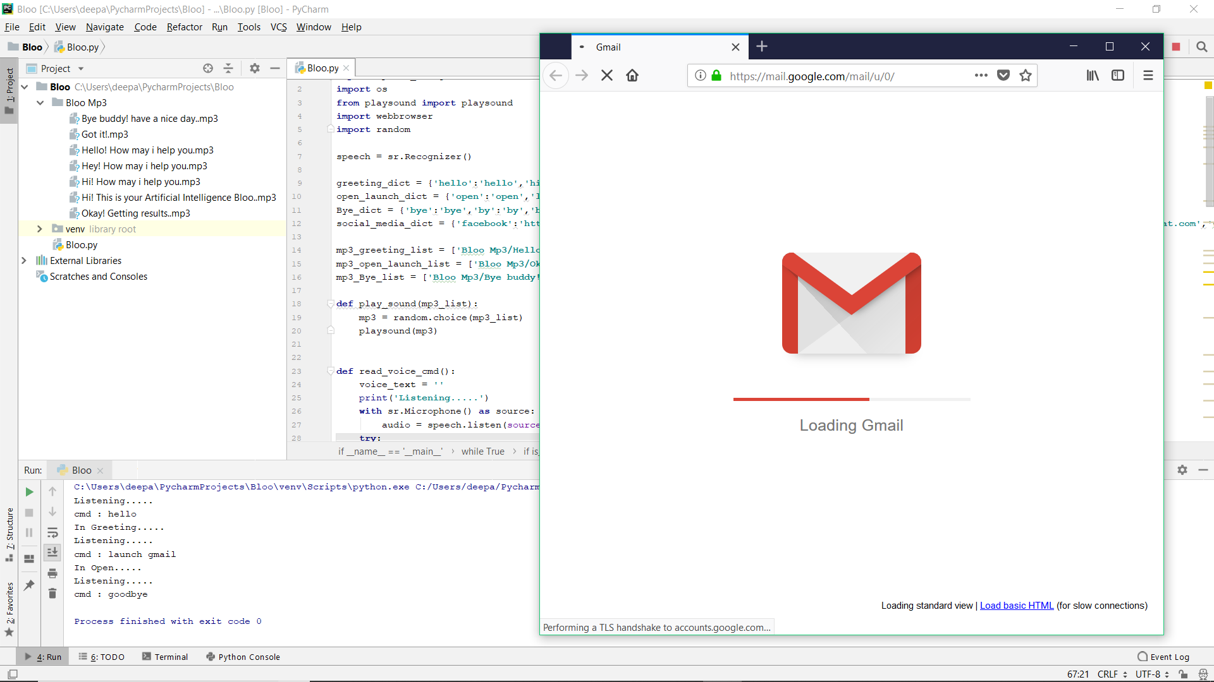
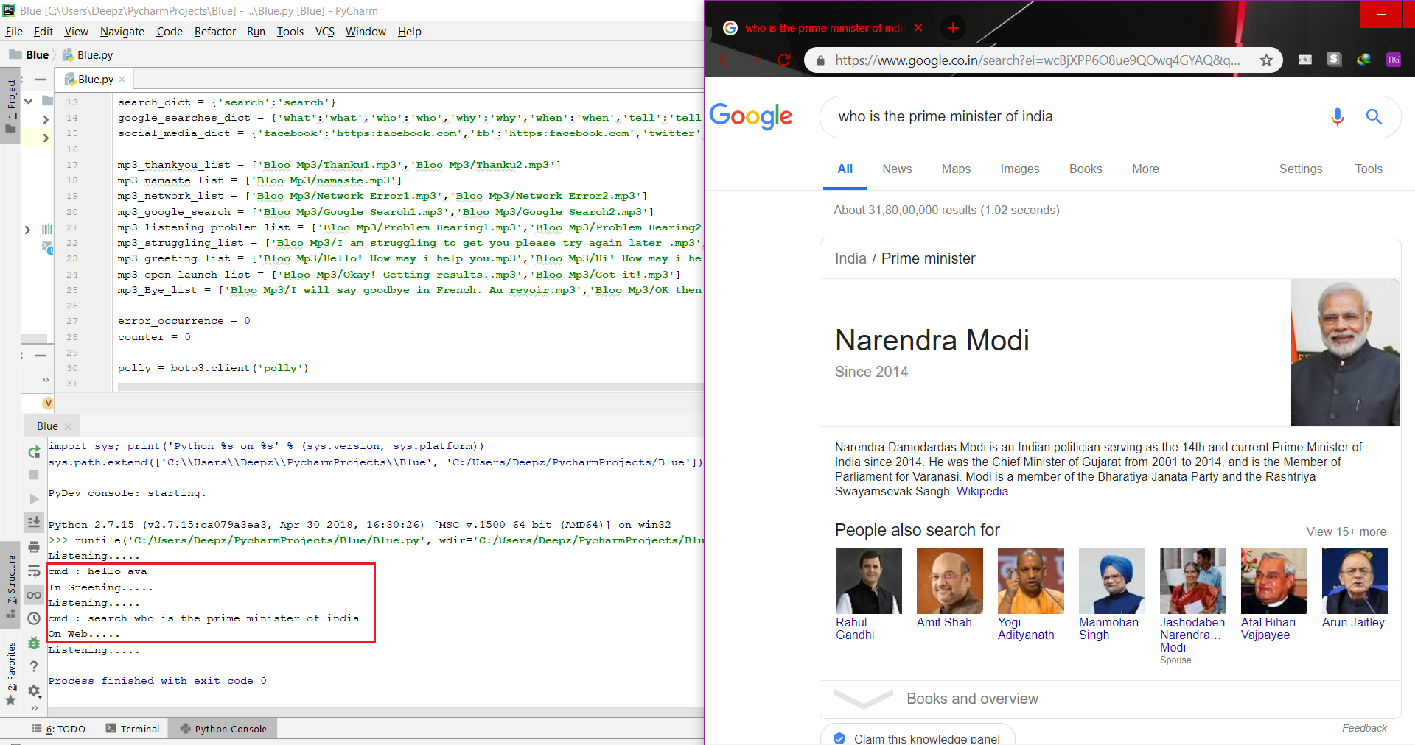
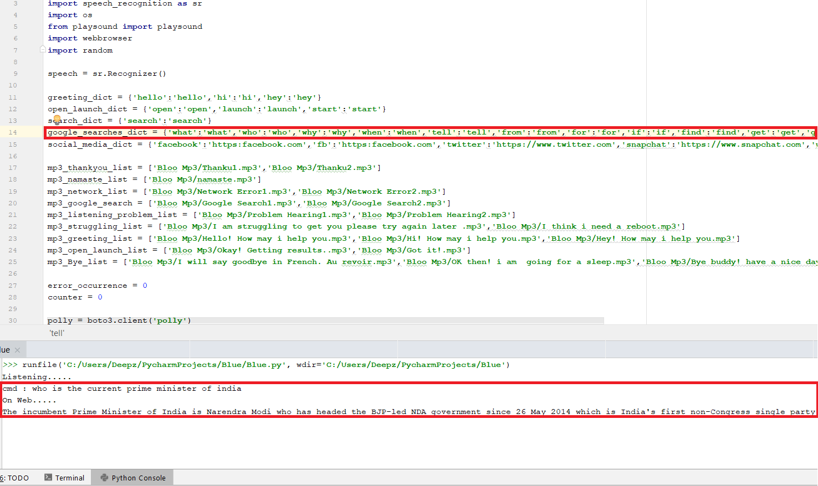
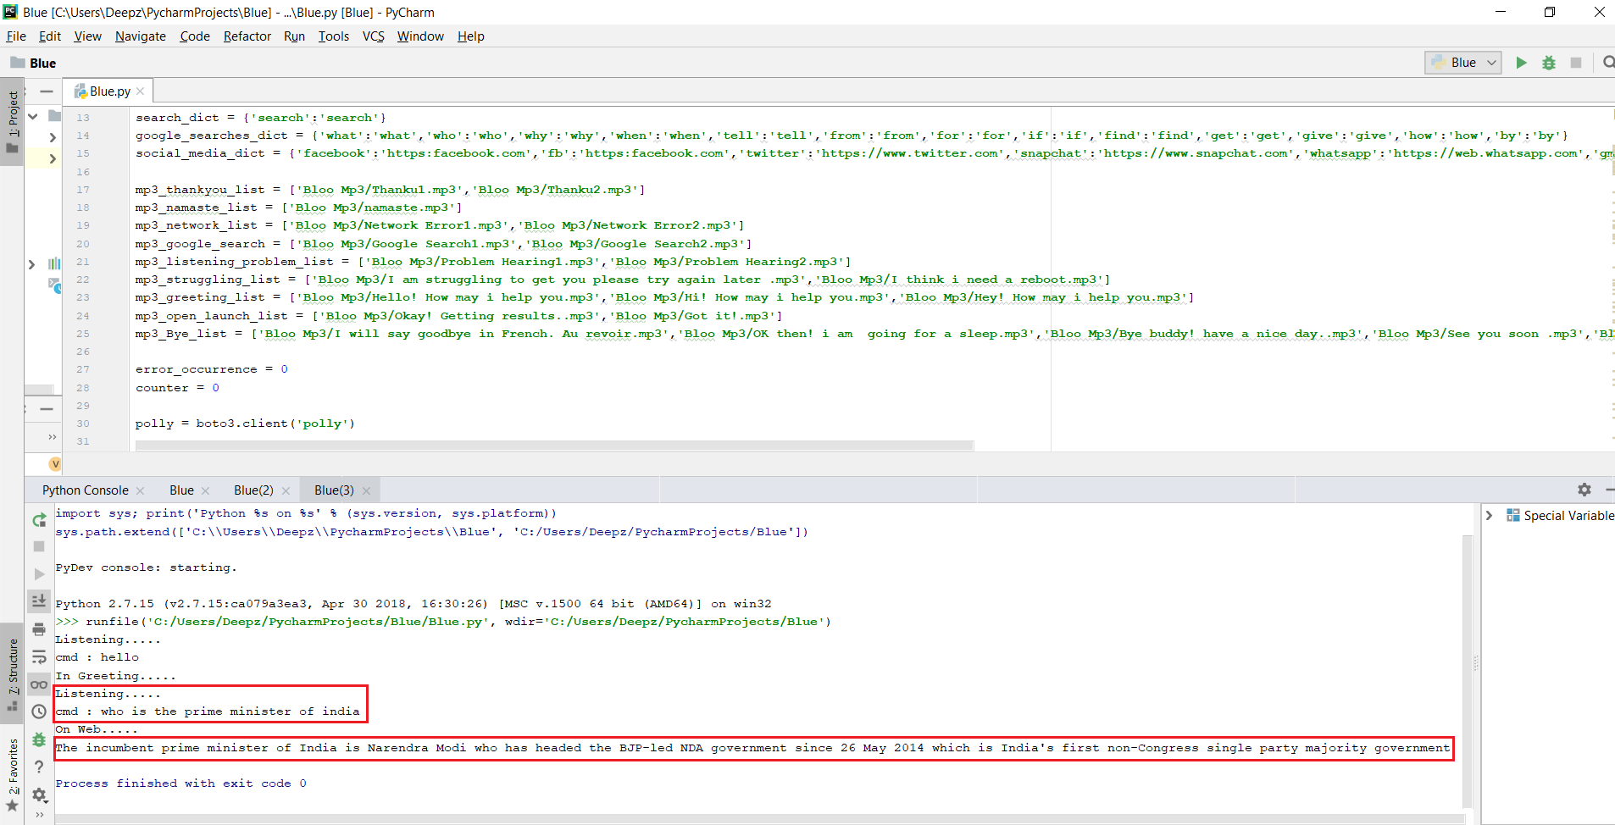
Response on commands to open Gmail:
Response on Google Search:
Response in Speech format:
Response in voice method:
Facebook

Slide 15
References
G. Bohouta, V. Z. Këpuska, "Comparing Speech Recognition Systems (Microsoft API Google API And CMU Sphinx)", Int. Journal of Engineering Research and Application 2017, 2017.
B. Marr, The Amazing Ways Google Uses Deep Learning AI.
Artificial intelligence (AI), sometimes called machine intelligence https://en.wikipedia.org/wiki/Artificial_intelligence
"CMUSphnix Basic concepts of speech - Speech Recognition process". http://cmusphinx.sourceforge.netlwiki/tutorialconcepts
Cortana Intelligence, Google Assistant, Apple Siri.
Hill, J., Ford, W.R. and Farreras, I.G., 2015. Real conversations with artificial intelligence: A comparison between human–human online conversations and human–chatbot conversations. Computers in Human Behavior, 49, pp.245-250.
K. Noda, H. Arie, Y. Suga, T. Ogata, Multimodal integration learning of robot behavior using deep neural networks, Elsevier: Robotics and Autonomous Systems, 2014.
Thakur, N., Hiwrale, A., Selote, S., Shinde, A. and Mahakalkar, N., Artificially Intelligent Chatbot.
Mohasi, L. and Mashao, D., 2006. Text-to-Speech Technology in Human-Computer Interaction. In 5th Conference on Human Computer Interaction in Southern Africa, South Africa (CHISA 2006, ACM SIGHI) (pp. 79-84).
Fryer, L.K. and Carpenter, R., 2006. Bots as language learning tools. Language Learning & Technology.
Huang, J., Zhou, M. and Yang, D., 2007, January. Extracting Chatbot Knowledge from Online Discussion Forums. In IJCAI(Vol. 7, pp. 423-428).

Slide 16
Thank You

